Slide 1
Logistic Regression

Slide 2
Logistic Regression - Topics
Introduction to Logistic Regression
Logit function in Logistic Regression
Probability Examples
Confusion Matrix
F1 Score, gini index and ROC curve
Pros and Cons of Logistic Regression
Case study on Logistic Regression

Slide 3
Introduction to Logistic Regression
In statistics, the logistic model is a statistical model that is usually taken to apply to a binary dependent variable.
In regression analysis, logistic regression or logit regression is estimating the parameters of a logistic model.
In Logistic Regression, the dependent variable is binary rather than continuous and it can also be applied to ordered categories (ordinal data).

Slide 4
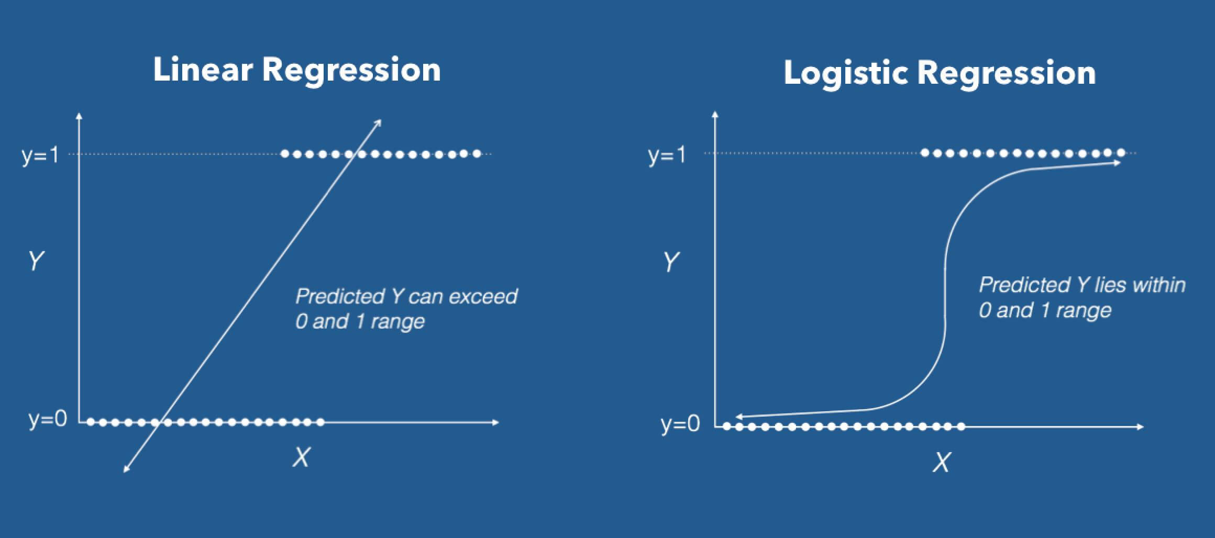

Slide 5
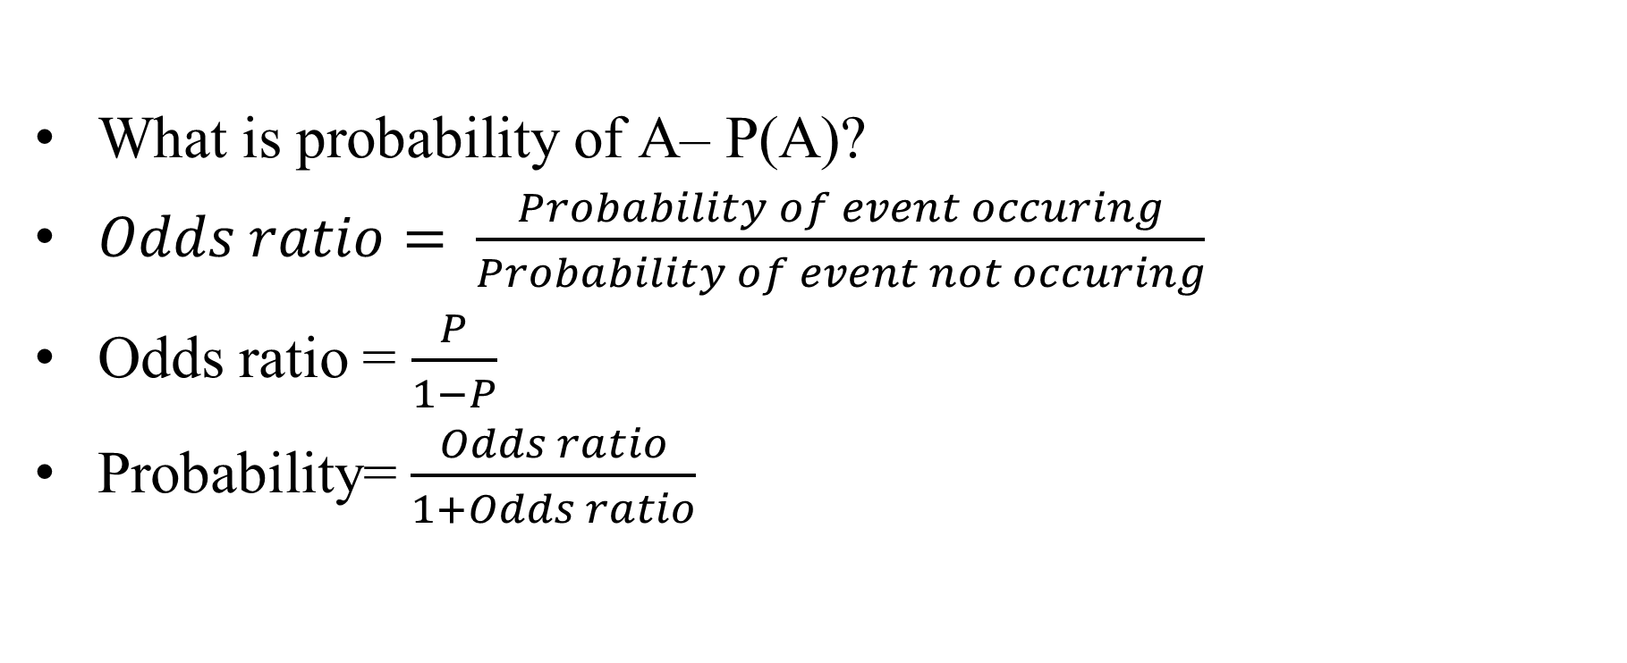
Odds vs Probability
What is probability of A– P(A)?
$Odds ratio= \frac{Probability of event occuring}{Probability of event not occuring}$
Odds ratio = $\frac{P}{1−P}$
Probability= $\frac{Odds ratio}{1+Odds ratio}$
Additional content: Not part of the video but will be useful for getting an industry perspective

Slide 6
The term “Odds”
Popular in horse races, sports, gambling, epidemiology,
Instead of talking about the probability of winning or contacting a disease, people talk about the odds of winning or contacting a disease
How are these two different?
Additional content: Not part of the video but will be useful for getting an industry perspective

Slide 7


Logit function in Logistic Regression
In logistic regression, the dependent variable is a logit, which is the natural log of the odds, that is,
Additional content: Not part of the video but will be useful for getting an industry perspective

Slide 8
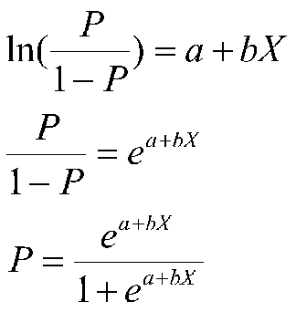
Math behind Logistic Regression
So a logit is a log of odds and odds are a function of P, the probability of a 1. In logistic regression, we find
logit(P) = a + bX,

Slide 9

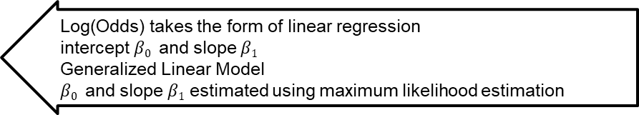
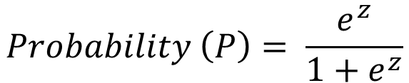
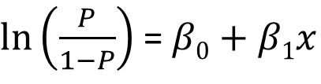
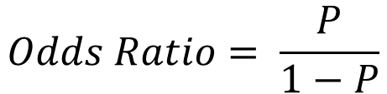
Math behind Logistic Regression
Predict likelihood or probability
Predicted value - >0 and <1
Use of sigmoid function to achieve this
$$Probability \left(P\right)= \frac{e^{z}}{1+e^{z}}$$
$$z= β0+β1x$$
$$Odds Ratio= \frac{P}{1−P}$$
Substituting for P, $Odds Ratio= \frac{P}{1−P}= e^{z}= e^{(β0+β1x)}$
Log(Odds) takes the form of linear regression
intercept $β0$ and slope $β1$
Generalized Linear Model
$β0$ and slope $β1$ estimated using maximum likelihood estimation
$ln⁡\left(\frac{P}{1−P}\right)$ = $β0+β1x$

Slide 10
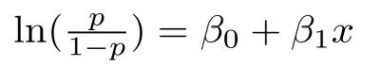
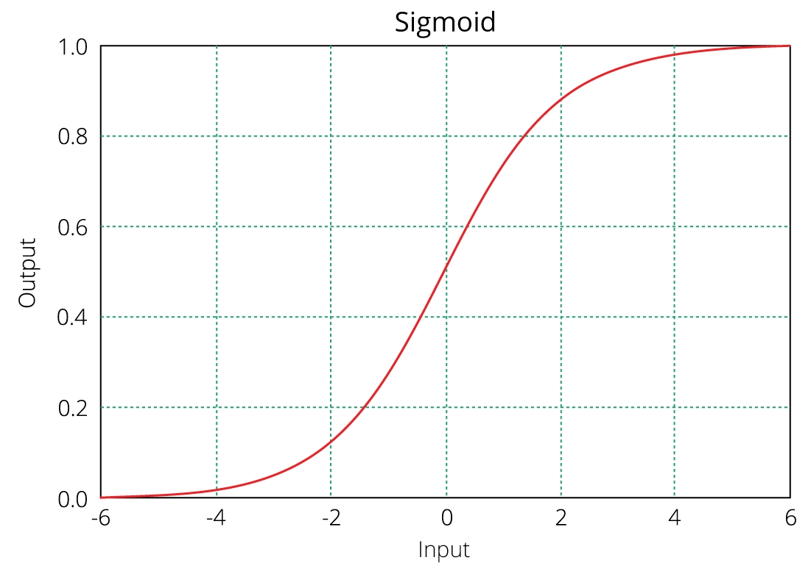
Equation of logistic regression
log - odds or odds ratio or logit function and is the link function for Logistic Regression
Regression intercept & coefficient
This link function follows a sigmoid function which limits its range of probabilities between 0 and 1.

Slide 11
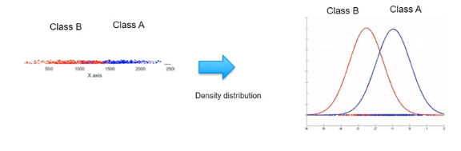
Probability Examples
Given the value of predictor (variable x), the model estimates the probability that the new data point belongs to a given class “A”. Probability values can range between 0 and 1.

Slide 12
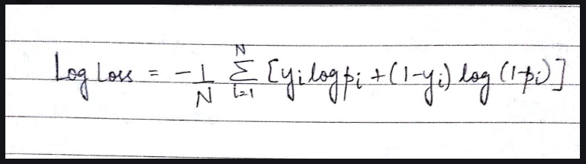
Class Blue – Non Diabetics
Class Red - Diabetics
Non Diabetics
The model has incorrectly classified in a couple of instances and correctly in other two.
Whenever there is a mistake done by model, the Log loss will increase. Substitute the value of
Yi = 0 for diabetics &
Yi = 1 for non diabetics and find what happens to the value of log loss
Diabetics

Slide 13
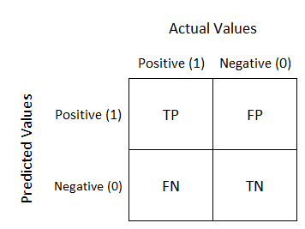
Confusion Matrix
Well, it is a performance measurement for machine learning classification problem where output can be two or more classes. It is a table with 4 different combinations of predicted and actual values.

Slide 14
Confusion matrix
 |  | Predicted
 |  | 0 | 1
Observed | 0 | TN | FP
 | 1 | FN | TP
Employees who will actually not attrite but predicted as will attrite
Employees who will actually attrite but predicted as will not attrite

Slide 15
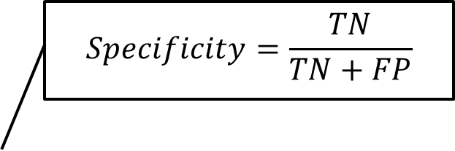
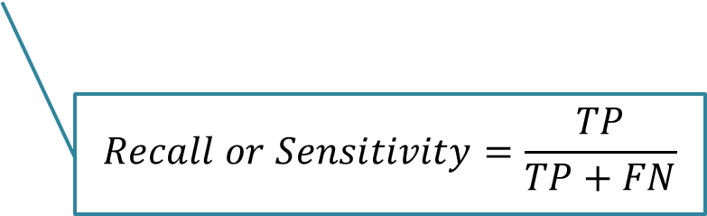
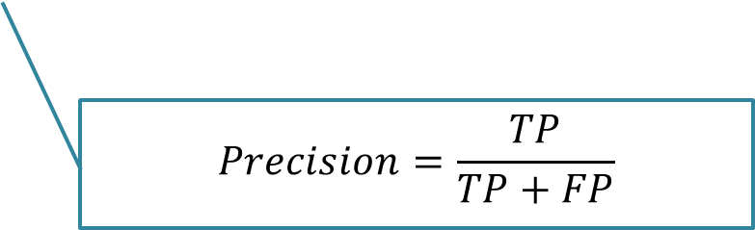
Confusion Matrix
 |  | Predicted
 |  | 0 | 1
Observed | 0 | TN | FP
 | 1 | FN | TP
$$Specificity=\frac{TN}{TN+FP}$$
$$Precision=\frac{TP}{TP+FP}$$
$$Recall or Sensitivity=\frac{TP}{TP+FN}$$

Slide 16
Why accuracy is not a good model performance measure?
Churn rate – 8%
Model predicts that no one churns
Accuracy – 92%
# Total customers – 100 # of customers who churn - 8
Misses out critical customers who churn

Slide 17
F1 Score
A single metric is not sufficient for the evaluation of classification models. We have seen that we need to use recall and precision together along with accuracy to evaluate our model.
Let us consider another metric that puts together the recall and precision metrics. We call it F1 Score.
F1 Score = 2(precision*recall)/precision + recall
-which is the harmonic mean of the two metrics.
The F1 score can also be used to evaluate the model.

Slide 18
ROC and Gini Coefficient and Threshold
Roc is a curve which allows us to compare models.
It is plot between TPR(true positive rates) and FPR(false positive ratio).
The area under the ROC curve (AUC) is a measure of the how good a model is.
Gini Coefficient:
It is also used to measure the goodness of a fit.
It is the ratio of areas in a roc curve and is scaled version of the AUC.
GI = 2*AUC -1

Slide 19
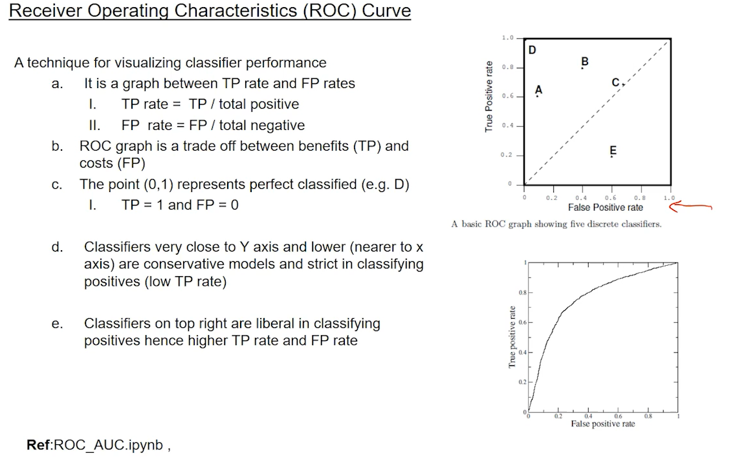
Strict models. Classifying all defaulter as defaulters -> but cost??

Slide 20
Pros and Cons of logistic regression
Pros:
It is a model that gives probabilities.
It can be easily scaled to multiple classes.
It is very quick to train and very fast at classifying unknown records.
Cons:
The classifies constructs liner boundaries.
Assumes that the variables are independent.
Interpretation of coefficients is difficult.

Slide 21
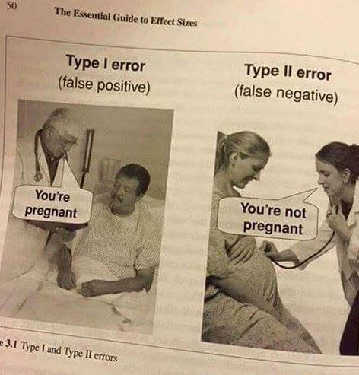
Confusion matrix: false positives, false negatives, true positives and true negatives.
Gain and lift: focus is on true positives.
ROC curve: focus on true positives vs. false positives.

Slide 22
Hands on exercise on Logistic Regression
Problem Overview
The dataset used here is Credit risk data.
Credit risk is nothing but the default in payment of any loan by the borrower. In Banking sector this is an important factor to be considered before approving the loan of an applicant. Dream Housing Finance company deals in all home loans. They have presence across all urban, semi urban and rural areas. Customer first apply for home loan after that company validates the customer eligibility for loan.
Company wants to automate the loan eligibility process (real time) based on customer detail provided while filling online application form. These details are Gender, Marital Status, Education, Number of Dependents, Income, Loan Amount, Credit History and others. To automate this process, they have given a problem to identify the customers segments, those are eligible for loan amount so that they can specifically target these customers. Here they have provided a partial data set.

Slide 23
Hands on Contd.
Dataset features:
Variable Description
Loan_ID Unique Loan ID
Gender Male/ Female
Married Applicant married (Y/N)
Dependents Number of dependents
Education Applicant Education (Graduate/ Under Graduate)
Self_Employed Self employed (Y/N)
ApplicantIncome Applicant income
CoapplicantIncome Coapplicant income
LoanAmount Loan amount in thousands
Loan_Amount_Term Term of loan in months
Credit_History credit history meets guidelines
Property_Area Urban/ Semi Urban/ Rural
Loan_Status Loan approved (Y/N

Slide 24
Hands on Contd.
Steps to follow:
1. Importing Libraries.
2. Check for the features, use the tools at your dispense to gather insights of the features.
3. Identify the opportunities to do the required pre processing of your data.
4. Get rid of the inconsistency, remove missing values.
5. Take 70:30 training and test set.
6. Fit the model on train data.
7. Check for the fit on the test data.

Slide 25


Questions?

